Slide 1
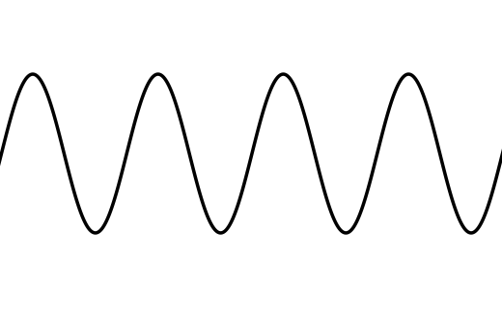
Fundamentals
Notes:
We assume some knowledge of DSP as a prerequisite, but these concepts will get us started with or without it.

Slide 2
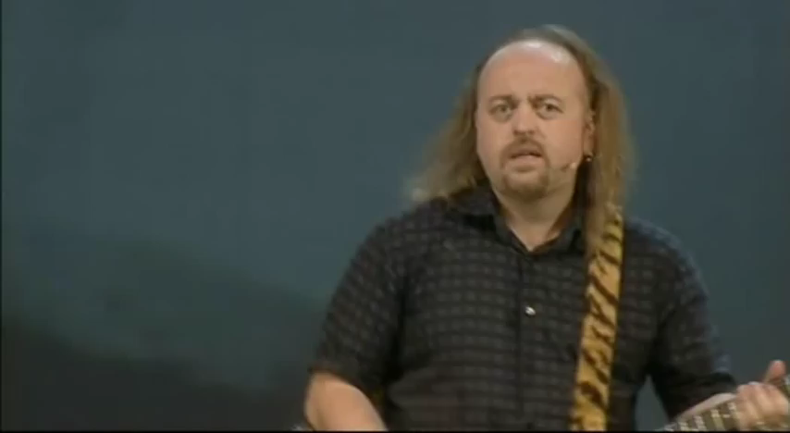
But first…

Slide 3
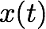
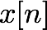
Continuous and discrete time
The physical world is continuous in space and time
Audio signals are (continuous) pressure waves
In analogue audio equipment, audio is represent by continuous voltage and current
Computers are discrete systems
Limited temporal and spatial/amplitude resolution
t is a continuous variable
(any real value)
n is a discrete variable
(only defined for integers)

Slide 4
Sampling
Discrete sequences do not have to represent any continuous or physical quantity
In the audio world, we often work with sampled audio
Sampling = converting continuous time to discrete
Reconstruction = discrete to continuous
T is called the sampling period
1/T is the sampling frequency or sample rate (fs)

Slide 5
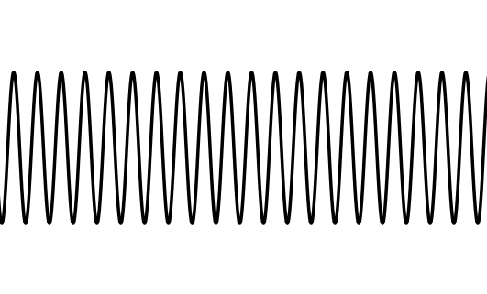
Sampling 2
Reconstruction is harder than sampling
Sampling inherently loses information
How do we distinguish between these two cases?
Need a band-limited input signal
Limited frequency range
Nyquist Sampling Theorem
Need to sample a signal at twice its highest frequency to be able to uniquely reconstruct it
This frequency is called the Nyquist frequency

Slide 6
Aliasing
Two sinusoids, one with frequency 0.3f_{s} and the other with frequency 0.7 f_{s}. They appear identical when sampled at frequency f_{s}.

Slide 7
Sampling and audio
What is a good sample rate for audio signals?
What’s the range of human hearing?
20Hz - 20kHz (approximately)
Suggests fs > 40kHz to accurately sample audio
What do we do if our signal isn’t band-limited?
Filter it: lowpass filter removes high frequencies
Every audio ADC (*analogue-to-digital converter) has an analogue front-end to prepare the signal before it is digitised
Similarly, every audio DAC has analogue post-filtering to remove digital artefacts
Sample rates in practice:
44.1kHz, 48kHz, 96kHz, 192kHz (why?)
Analogue filters not ideal: need extra margin
Some digital processing better done at higher sample rate
Notes:
ADC / DAC design is a fascinating topic, but unfortunately beyond the scope of this text. We will assume digital signals as a basis, but we should know where they come from.

Slide 8
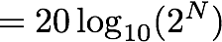
Sampling and audio 2
Digital systems are limited in precision as well as sample rate
Each sample stored with a fixed number of bits (bit depth)
Bit depth determines number of discrete levels that can be represented
8 bits = 2⁸ = 256 levels
16 bits = 2¹⁶ = 65536 levels
24 bits = 2²⁴ = 16777216 levels
Bit depth determines maximum dynamic range
Ratio of loudest to softest signal
Human hearing: 140dB dynamic range
decibel scale
for N bits
Notes:
How many bits are theoretically required to represent the dynamic range of human hearing? Why can’t we represent the whole range in practice?

Slide 9
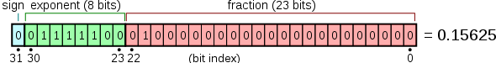
Sampling and audio 3
Other reasons we care about bit depth
Why not use as many bits as possible?
Memory, computational complexity
Quantisation noise
Error left over from digitising a signal
Purely digital effects can also generate quantisation noise
Rounding error on calculations, etc.
Sampling bit depth ≠ processing bit depth
High-end ADCs sample at 24 bits
Audio processing done at 32 or 64 bits, floating point
Single or double precision (contrasts with fixed point)
IEEE 754 single-precision floating point (Wikipedia)
Notes:
On computers, it’s common to process audio at a higher bit depth than it is sampled at. This minimises numerical errors during calculations and potentially even prevents instability in certain effects. Most of the time, calculations are done in floating point, where some of the bits are reserved to hold information on the scale of the number. Floating point can represent a greater range of values than fixed point, but it is more computationally expensive. Many low-power DSP systems are fixed point, which is computationally equivalent to working with integers and thus much easier. A greater burden is placed on the programmer to understand the proper scale of each variable in this case.

Slide 10
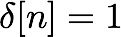
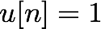
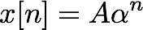
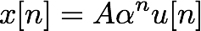
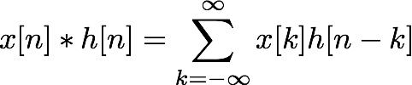
Useful digital sequences
Impulse
for n = 0; 0 otherwise
For LTI systems, we’ll often talk about impulse response
Step
for n >= 0; 0 otherwise
Exponentials
Right-sided exponential:
Convolution of two signals

Slide 11
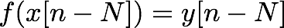
Properties of digital systems
x[n]
f
y[n] = f(x[n])
Linearity:
Time invariance:
Linear, Time-Invariant (LTI) systems are a common useful case
Stability:
x[n] bounded y[n] bounded
Causality:
x[n] = 0 for n < 0 y[n] = 0 for n < 0
f doesn’t depend on any future sample (i.e. greater n)
Memorylessness:
y[n] only depends on the current value of x[n]
Notes:
Useful properties to know. Which audio effects satisfy or break these properties?

Slide 12
Complex number a+jb=re^{jθ} depicted in the complex plane. Unit circle, cosθ+j sinθ =e^{jθ} is also depicted.
Imaginary axis
b
r
θ
a
Real axis

Slide 13
Time domain block diagram of a digital linear filter
x[n]
Delay
...
Delay
b₀
b₁
b_{N}
y[n]
Sum
-a_{N}
-a₁
Delay
...
Delay

Slide 14
Z-domain block diagram of a digital linear filter
X(z)
z⁻¹
...
z⁻¹
b₀
b₁
b_{N}
+
Y(z)
-a_{N}
-a₁
z⁻¹
...
z⁻¹

Slide 15
Pole zero plot (a), impulse response (b), magnitude response (c) and phase response (d) of a digital linear filter
(a)
(b)
(c)
(d)

Slide 16
Buffering
How do we implement an effect in practice?
Two memory buffers
One contains the input signal, the other starts empty
Go through sample-by-sample, run a function on the input to calculate an output sample
The function could depend on the current sample, or any combination of previous samples (see casuality and memorylessness)
. . .
x[0]
x[1]
x[2]
x[3]
x[4]
x[5]
x[6]
x[7]
x[8]
x[9]
x[10]
x[11]
x[12]
. . .
. . .
y[0]
y[1]
y[2]
y[3]
y[4]
y[5]
y[6]
y[7]
y[8]
y[9]
y[10]
y[11]
y[12]
. . .

Slide 17
Buffering
Audio signals could be of any length
For real-time signals, we don’t know the length
We can’t hold all this in memory at once
Fortunately, once we’ve played back a sample or recorded it to disk, we can usually forget about it
Moving audio samples in memory is wasteful
x[0]
x[1]
x[2]
x[3]
x[4]
x[5]
x[6]
x[7]
x[8]
x[9]
x[10]
x[11]
x[1]
x[2]
x[3]
x[4]
x[5]
x[6]
x[7]
x[8]
x[9]
x[10]
x[11]
x[12]
x[2]
x[3]
x[4]
x[5]
x[6]
x[7]
x[8]
x[9]
x[10]
x[11]
x[12]
x[13]
NO (don’t move 11 samples to add 1)

Slide 18
Buffering FIX
Some pseudocode...
x=zeros(100,1);
X[1]=1; % unit impulse signal of length 100
g=0.5;
Delayline=zeros(10,1); % memory allocation for length 10
for n=1:length(x);
y[n]=x[n]+g*Delayline[10];
Delayline=[x(n);Delayline(1:10-1)];
end;
Inefficient
(though it’s fine to demonstrate the concept)
Useful C/C++ points:
Arrays / buffers are indexed starting at 0 in C/C++ (versus 1 for matlab)
Use brackets to access elements of an array (like our [] notation)
Semicolon ends a line

Slide 19
Circular buffering
Circular buffer acts like a loop
Write from beginning to end, then go back to the beginning again
Always holds the most recent samples without moving them
Keep track of the write pointer to know where you are
Implemented with modulo arithmetic
write pointer
x[0]
x[1]
x[2]
x[3]
x[4]
x[5]
x[6]
x[7]
x[8]
x[9]
x[10]
x[11]
x[12]
x[1]
x[2]
x[3]
x[4]
x[5]
x[6]
x[7]
x[8]
x[9]
x[10]
x[11]
x[12]
x[13]
x[2]
x[3]
x[4]
x[5]
x[6]
x[7]
x[8]
x[9]
x[10]
x[11]
YES (samples stay in place)

Slide 20
Buffering in real-time
Another reason to buffer audio samples
44.1kHz audio has a sampling period of 22.6µs
Modern multitasking OSes put many demands on the CPU
Processor won’t be available for audio every 22.6µs
Solution: collect multiple samples into a buffer to process
Typical buffer sizes: 32 to 1024 samples
Usually a power of 2 for computational efficiency
What’s the tradeoff?
Latency
Delay from input to output
Can be a big problem for DAFX
Musicians can detect latencies as low as 2ms
Keep buffer as small as possible before dropouts

Slide 21
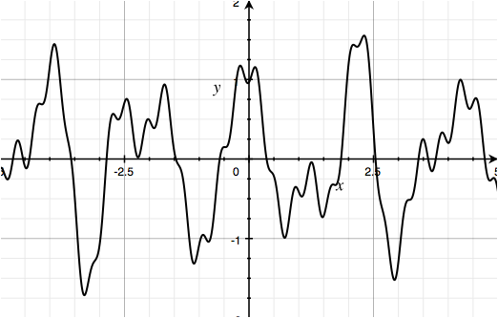
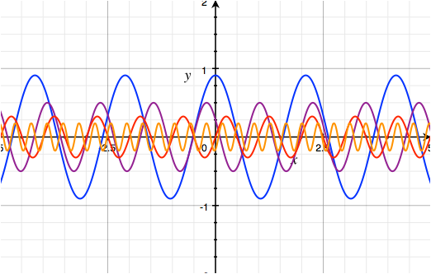
Time and frequency domain
Any digital signal can be represented as a sequence of samples (known as the time domain)
..., x[-2], x[-1], x[0], x[1], x[2], ...
It can also be represented as a sum of sinusoids
Again, true of any signal! (not just periodic ones)
=

Slide 22
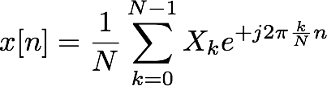
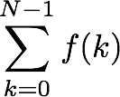
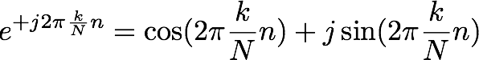
Time and frequency domain
So any x[n] can also be represented as a sum of sinusoids...
So let’s do that then!
of weighted
Our time domain signal is...
the sum
sinusoids
*with a scaling factor we’ll talk about in a bit
means add up the function f(k) for every
(integer) value of k between 0 and N-1
is a complex exponential (e^{x} when x is complex produces a complex cosine/sine wave)

Slide 23
Time and frequency domain
So any x[n] can also be represented as a sum of sinusoids...
So let’s do that then!
The second version is called the frequency domain representation of x
* or at least discrete samples of the frequency domain...
What frequencies are present, with what amplitude and what phase? From this we can exactly determine x[n].
We will use both time domain and frequency domain to understand digital audio effects

Slide 24
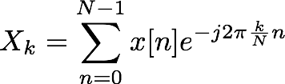
Fourier transforms
This equation:
...is known as the Inverse Discrete Fourier Transform (IDFT)
The Fourier Transform is a mathematical formula which converts from time to frequency domain
The traditional Fourier Transform is for continuous-time signals
The Discrete Fourier Transform (DFT) is the same idea for discrete-time sequences (and discrete frequencies)
The DFT: time frequency
The IDFT: frequency time
*and the scaling factor makes DFT IDFT balance out

Slide 25
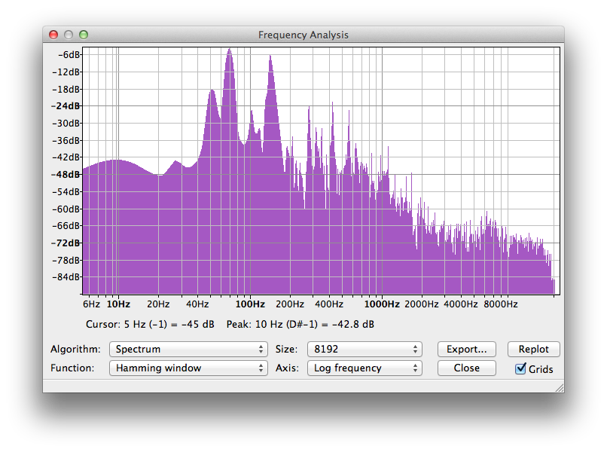
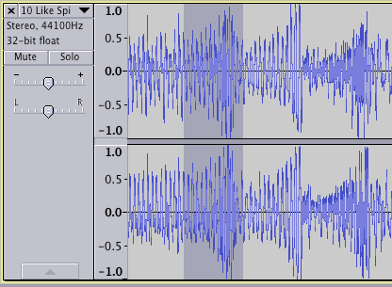
The FFT
The DFT finds the frequency content of a discrete-time (finite length) signal
So what’s the FFT?
Fast Fourier Transform
It’s just a fast algorithm for calculating the DFT!
Whenever we see a spectrum in digital audio, it has been calculated with the FFT
Time
Frequency (post-FFT)

Slide 26
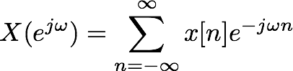
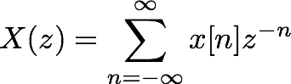
DTFT and z-transform
Discrete-Time Fourier Transform of a digital sequence
Samples of x[n] referred to as time domain
Values of known as frequency domain
Notice that this function is continuous
represents frequency: ranges from 0 to 2π
Contrast this to continuous-time frequency
z-transform is an abstraction of the DTFT
Useful for assessing behaviour of discrete time systems
DTFT is a special case
Notes:
This takes a bit of maths to justify, and we will assume it’s familiar from a previous DSP module. See any DSP text for the derivation and significance

Slide 27
The time domain waveform (a), frequency domain power spectrum (b) and spectrogram of a 3 second excerpt of solo guitar performance.
(a)
(b)
(c)

